Slide 1


SAP APM
No SAP Credentials
Version 1.0
April 2025

Slide 2
Accenture Credentials – Summary (1/2)
Non-Exhaustive
We have been involved in several successful engagements with similar expertise requirement
# | Project | Industry | Description | Value Unlocked
1 | Maintenance tactics review | Metal & Mining | Develop Playbook for Asset Maintenance Tactics Approach & detailed activities to conduct asset tactics review Frameworks, decision criterion & processes to be used Site Diagnostics and Implementation | Increased asset availability leading to increased production Reduced maintenance cost with reduction in breakdown maintenance Improved maintenance planning with better material visibility & manpower requirement
2 | Maintenance strategy review | Metal & Mining | Reviewed existing maintenance practices and benchmarked against industry leading practices Conducted a review of total cost of maintenance for mining equipment Developed a framework for estimation of cost in In House and Outsourced Maintenance and developed a costing model for In House maintenance | Identified and established cost savings opportunities in the range of 7-12% of total maintenance cost Developed mining equipment maintenance strategy Developed a reusable tool as a decision-making framework
3 | Maintenance & Reliability transformation | Metal & Mining | Perform as is assessment and identify gaps in existing standards, procedures, guidelines and operating model applicable to maintenance & reliability functions Create playbooks related to Reliability, Work Management Process , Asset Data Management, Asset Management & Reliability Organization and Assessment & Compliance Implement initiatives for identified value opportunities | Implement reliability, asset data management and work management value opportunities across 5 pilot sites Increase in availability of 5-10% Maintenance spend reduced by $ 150 MN Increase in worker efficiency by 15-20% Reduced production variance
4 | Condition monitoring & failure prediction of fixed & mobile assets | Metal & Mining | Build Technology solution to connect various data sources (Multipoint analytics solutions, Cloud, PI, Historian, MHM) Implement a technology digital solution to enable Maintenance & reliability teams and MECOE personnel to predict equipment downtime for Fixed Plant equipment | Reduced Maintenance Costs Increased Productivity Increased Robustness Increase plant availability from reduced scheduled downtime
5 | Maintenance Readiness | Metal & Mining | Accenture team leveraged Maintenance readiness framework to identify the key capabilities and processes required to run plant smoothly Helped to timely identify the key gaps in Maintenance capabilities and bridge to avoid impact on plant maintenance | Supported client to build the maintenance capabilities in following areas: Master Data Management Maintenance Strategy Equipment Health Check Mechanism Maintenance Manuals
Assessment/Vision/Roadmap
Functional Initiatives Implementation
Software Implementation
Rio Tinto
Glencore
VALE
BHP
Tata Steel Minerals Canada Limited

Slide 3
Accenture Credentials – Summary (2/2)
Non-Exhaustive
We have been involved in several successful engagements with similar expertise requirement
# | Project | Industry | Description | Value Unlocked
1 | Asset and Material Data Management | Energy | Catalogued ~100,000 materials and build Bill of material Build ~250,000 FLOCs & equipment & reviewed ~35,000 maintenance plan & task list Established governance mechanism for data quality control | Correct and adequate material data ensured reduction in stock out situation by ~ 15% Improved visibility of maintenance and material requirement resulted in reduced operating expenditure from 120% to 75% & improved planning efficiency by 10-20%
2 | Reliability & Integrity Management program | Oil & Gas | Equipment criticality analysis for all the plant equipment according to organization’s own standards Failure Mode and Effect Analysis for all critical equipment Optimization Strategy: Development of work processes and enablers to allow the optimization of maintenance expenditures regarding plant availability | Improved collaboration with better data availability/ quality/ integration—increases shared data usage across organization Increased asset reliability and availability Enhanced production time Reduced maintenance and spare costs
3 | Maintenance & Reliability Improvement | Oil & Gas | Standardization done in maintenance processes and procedures Reviewed & updated maintenance strategies to achieve benchmark PM & CM ration Reviewed spare parts management | Further integration of upstream, petrochemicals and retail enhances refinery utilization. Asset management strategy provides reliable assets to fully utilize potential. Cost reduction program saved ~100M in 2013
4 | Asset reliability & maintenance management | Oil & Gas | Qualitative review of current performance through a structured assessment of current maintenance practices and procedures using ARMM (Asset Reliability and Maintenance Management) tool Quantitative review through a structured Key Performance Indicator (KPI) assessment Defined an implementation roadmap that covered strategic objectives & KPIs for the maintenance function and proposed strategic solutions and activities to address the improvement areas identified in the first phase. | Strategic solutions were consolidated into 6 initiatives to be implemented by client over a period of 18 months with following objectives: Maintenance Strategy Management Organization & Capability Management Inventory Management Maximized the availability of assets by eliminating unplanned shutdowns and completing all planned maintenance on time Maximized value from manpower and services by renewing organization focus on reliability-based maintenance
5 | Maintenance Improvement | Oil & Gas | Reviewed as-is situation with quantitative and qualitative data across Contractor management, Shutdown management, Equipment Performance Monitoring, Maintenance Execution, Asset Integrity Management, Equipment Specific Strategy, Maintenance Planning and Scheduling | A 2-stage roadmap was prepared for each division to help them achieve global benchmarks in their respective areas
Assessment/Vision/Roadmap
Functional Initiatives Implementation
Software Implementation
Inpex
Jazan Gas
Petrom
Erdemir
Maersk Oil

Slide 4
Credential - Comprehensive Maintenance Tactics Review Process
Client Profile
Business Challenges
Solution
Outcomes & Value
Company is an integrated iron ore operations based in Western, Australia. The setup includes 16 iron ore mines, 4 independent port terminals and 1,700-kilometre rail network and related infrastructure.
RTIO maintenance tactics processes are not integrated and are inconsistent across sites, resulting in high scheduled and unscheduled losses
Common issues faced across sites:
Multiple maintenance procedures are available but not integrated
Missing maintenance tactics for maintainable items
Maintenance frequency inconsistent with failure frequency
Incorrect material assignment in maintenance task lists
Asset strategy and tactics review playbook will be developed for RTIO and a pilot will be conducted to build and test playbook recommendations
1
Develop Playbook for Asset Maintenance Tactics
End-to-end process with RACI matrix defined
Approach & detailed activities to conduct asset tactics review
Frameworks, decision criterion & processes to be used
Illustrative outcomes of a typical asset tactic review
Training slideware with step-by-step screenshots
Outcomes
Playbook for Asset Maintenance Strategy Review
Site Diagnostics and value case development
Training Guide for Asset Maintenance Strategy Review
Updated Tactics of priority assets for priority site
Value
Increased asset availability leading to increased production
Reduced maintenance cost with reduction in breakdown maintenance
Improved maintenance planning with better material visibility & manpower requirement
2
Site Diagnostics and Implementation
Actionable value diagnostics which will result in insights
Implement improvements across maintenance tactics review domain
Conduct training sessions for key site reliability stakeholders

Slide 5
Credential – Maintenance and Operational Readiness through Standard Work Procedure Development
Client Profile
Business Challenges
Solution
Outcomes & Value
Client is an Anglo-Australian multinational and the world's second-largest metals and mining corporation, producing iron ore, copper, diamonds, gold and uranium.
REVENUE: $63.495 BILLION
EMPLOYEES: 45,000
In 2006, Client acquired 9.9 per cent stake in Ivanhoe Mines of Canada, to jointly develop the copper-gold resource in Mongolia's With plans to begin production in August 2012 and reach full production in 2018.
Considering the enormity of work/machinery present on site client needs support devising operation & maintenance procedure for the mine. Since majority of the SMEs were engaged in the commissioning activities and the second line of workforce was Mongolian nationals with little experience in either operation / maintenance of the mine, it was a challenge to develop these procedures with optimal use of SMEs, local and vendor support.
Accenture developed a phased approach to identify key operations and maintenance tasks / Areas and than focused on business-critical tasks based on outcome of risk assessment workshop with the SMEs
RCM & FMEA workshop
To optimize PM
Bringing in operational/ mining expertise to ensure development of high-quality procedures to enable client meet onsite safety standards.
Developing documents in areas across Open pit, Underground, Coal Handling Plant, Concentrator etc. which are re-usable by client and easy to understand by Mongolian work force.
Detailed procedures
For maintenance task
Comprehensive task identification
Adopting best practices

Slide 6
Credential – Maintenance Strategy
Client Profile
Business Challenges
Solution
Outcomes & Value
Client is an Anglo-Swiss multinational commodity trading and mining company . It is one of the world's largest diversified natural resource companies, producing and marketing more than 90 commodities, a network that spans over 50 countries
REVENUE: $142.34 BILLION
EMPLOYEES: 145,000
Mining Equipment category had high impact on overall organization performance due to importance of the function and high cost.
Client engaged Accenture to prepare maintenance strategy. Its Objectives were to:
Create Outsource vs In-house maintenance decision framework
Improve maintenance KPIs including reduction in total cost of maintenance
Ensure Security of Supply
Reviewed existing maintenance practices and benchmarked against industry leading practices
Conducted a review of total cost of maintenance for mining equipment
Developed a framework for estimation of cost in In House and Outsourced Maintenance and developed a costing model for In House maintenance
Compared in-house and outsourced maintenance arrangements in terms of Total Cost of maintenance and performance and evaluated the risk associated with each model
Compared the costing of In-House vs Outsourced maintenance models for all sites and quantified cost benefits and possible impacts on performance
Identified and established cost savings opportunities in the range of 7-12% of total maintenance cost through In-house and other hybrid maintenance operations
Developed mining equipment maintenance strategy for the client
Developed a reusable tool as a decision-making framework to enable client to make Maintenance and Repair sourcing decisions in the future and facilitated the knowledge transfer and handover of these tools
Identification of strategic, commercial and operational initiatives and classify based on impacts and implementation timelines
Identified quick wins
Identified Risks associated with Outsourced, In-house and other hybrid Maintenance models and prepared risk mitigation plan

Slide 7
Credential – Maintenance and Reliability Transformation
Client Profile
Business Challenges
Solution
Outcomes & Value
Client is a Brazilian multinational corporation engaged in metals and mining and one of the largest logistics operators in Brazil
REVENUE: $34 BILLION
Client wants to achieve digital predictive maintenance by 2022 and aims to have more standardized, stable and predictable operations by increasing safety and reducing operational costs. Key challenges faced by the client are:
Low reliability of equipment resulting in costly reactive maintenance
Low availability of equipment resulting in throughput loss
Non standardized master data
Perform as is assessment and identify gaps in existing standards, procedures, guidelines and operating model applicable to maintenance & reliability functions
Create playbooks related to Reliability, Work Management Process , Asset Data Management, Asset Management & Reliability Organization and Assessment & Compliance
Train client personnel in reliability, work management and asset data management areas
Perform diagnostics to identify potential value opportunities in maintenance and reliability functions
Implement initiatives for identified value opportunities across sites
Build client’s reliability capability through Train the Trainer program
Implement reliability, asset data management and work management value opportunities across 5 pilot sites
Scale up the implementation to 15 sites over 16 months program
Monitor and sustain value
Increase in worker efficiency by 15-20%
Increase in availability of 5-10%
Maintenance spend reduced by $ 150 MN
Reduced production
variance

Slide 8
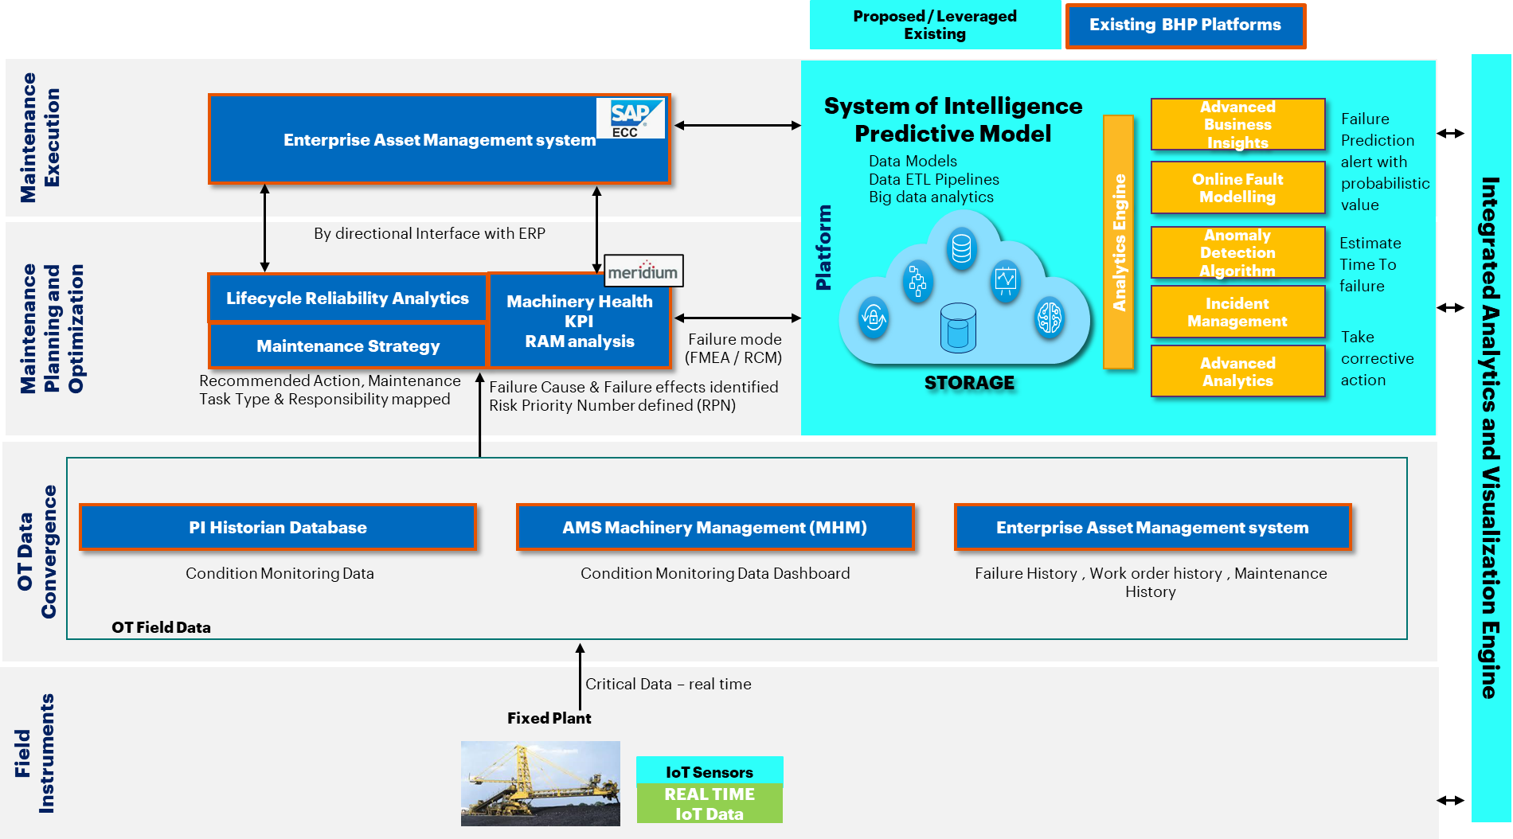
Credential – Live Condition Monitoring and Failure Prediction of Fixed And Mobile Assets for a Mining Major
Client Profile
Business Challenges
Solution
Outcomes & Value
Client is an Australian multinational mining, metals, natural gas petroleum public company
REVENUE: $60.8 BILLION
EMPLOYEES: 80,000
Siloed processes, isolated teams and too many disconnected data sources are affecting the asset reliability and predictive maintenance areas.
The manual processes and interpreting/actioning analysis data is a slow and difficult process.
Build Technology solution to connect various data sources (Multipoint analytics solutions, Cloud, PI, Historian, MHM)
Develop visualization tool to display and send alerts to end users.
Implement a technology digital solution to enable Maintenance teams, site Reliability teams and MECOE personnel to predict equipment downtime / failure for Fixed Plant equipment.
• Reduced Maintenance Costs – Potential issues to be detected earlier and be rectified before they become more problematic and costly
• Increased Productivity – Maintenance activities to be performed at more efficient intervals resulting in a reduction in unscheduled downtime.
• Increased Robustness – Failure prediction to be used to move equipment off the critical path when failure is imminent
• Increase plant availability from reduced scheduled downtime

Slide 9
Credential – Maintenance Readiness
Client Profile
Business Challenges
Solution
Outcomes & Value
Client is a developing green field Direct Shipping Ore (DSO) and partnership between Tata Steel (82%) and the Government of Quebec (18%)
REVENUE: $4.67 MILLION
EMPLOYEES: 70,000
Client was developing green field Direct Shipping Ore (DSO) project which involves mining, crushing, washing, screening and shipping the sinter fines and pellet fines with three processing units
On Commissioning of 1st unit, client faced severe downtime due to lack of maintenance capabilities which has impacted the entire cash flow realization
Client took help from Accenture to evaluate the existing maintenance capabilities and support to build appropriate Maintenance capabilities and processes to sustain the plan operations and avoid future unplanned downtimes
Accenture team leveraged Maintenance readiness framework to identify the key capabilities and processes required to run plant smoothly
Conducted workshops with operations, HSE, Maintenance organization stakeholders to ascertain the maintenance capability gaps as process, people and technology
Based on AS IS evaluation, Accenture team created project plan and provided functional/technical support to build the required key capabilities.
This helped to timely identify the key gaps in Maintenance capabilities and bridge to avoid impact on plant maintenance
Supported client to build the maintenance capabilities in following areas:
Master Data Management
Maintenance Strategy
Equipment Health Check Mechanism
Maintenance Manuals
Maintenance Organization and Document Management is now efficient

Slide 10
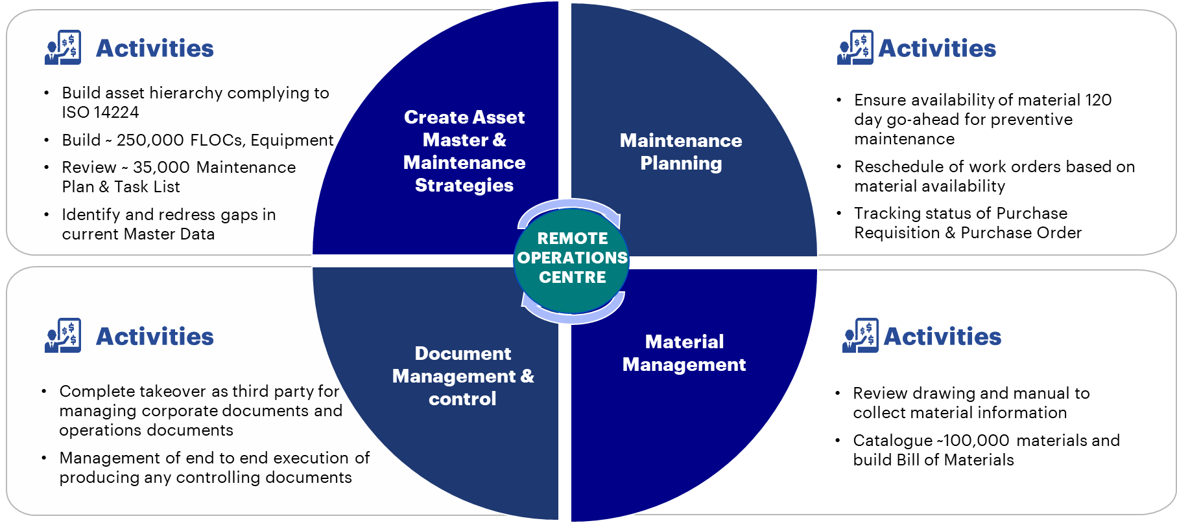
Credential – Asset and Material Data Management
Client Profile
Business Challenges
Solution
Outcomes & Value
Client is a Japan’s largest oil and gas exploration and production company. It is Involved in over 70 projects across more than 20 countries
REVENUE: $ 11.3 BILLION
Client aspires to be a top quartile energy company in operational efficiency and cost competitiveness while maintaining high level of safe, reliable and productive assets. Client was facing challenges such as
High operating costs
Poor asset master data
Improper plant maintenance practices
Lack of visibility & digitization
Standardized asset master data standards
Prepared look ahead plan of 120 days for maintenance planning
Improved visibility of maintenance and material requirement resulted in reduced operating expenditure from 120% to 75% & improved planning efficiency by 10-20%
Correct and adequate material data ensured reduction in stock out situation by ~ 15%

Slide 11
Credential – Reliability & Integrity Management Program
Client Profile
Business Challenges
Solution
Outcomes & Value
Client is a Saudi Arabia-based publicly traded company that operates primarily in oil & gas
REVENUE: $ 3.62 MILLION
EMPLOYEES: 288
Client is building a 400MBPD grassroots refinery and hydrocarbon terminal facilities. In order to be economical, reliable, safe, and compliant operator; client partnered Accenture to develop and implement ‘integrated manufacturing Operations Management through combination of business process & technology guided through organizational governance, roles and responsibilities
A key component includes implementation of Lifecycle, Reliability, & Integrity System (LRIS), which will enable desired reliability and integrity management functionalities to enhance asset life-cycle plants while optimizing overall asset management costs
Scope of work included Equipment Criticality Analysis followed by FMEA study on critical equipment to develop equipment-oriented maintenance strategies and a comprehensive maintenance plan to address asset maintenance issues.
Accenture structured the program into smaller modules to deliver the intended results:
Plant Reference model and Asset Hierarchy development with detailed equipment information
Equipment criticality analysis for all the plant equipment according to organization’s own standards
Failure Mode and Effect Analysis for all critical equipment (rotating equipment)
Corrosion Management program for static equipment
Equipment Strategies: Work processes and associated enablers that are needed to enable the deployment of different maintenance strategies
Optimization Strategy: Development of work processes and enablers to allow the optimization of maintenance expenditures regarding plant availability
Maintenance Readiness and Operation Readiness for commissioning plants.
Improved insights to asset performance and asset criticality
Improved collaboration with better data availability/ quality/ integration—increases shared data usage across organization
Increased asset reliability and availability
Extended equipment life through better control on maintenance activities
Enhanced production time
Reduced maintenance and spare costs

Slide 12
Credential – Maintenance & Reliability Improvement
Client Profile
Business Challenges
Solution
Outcomes & Value
Client is one of the largest corporations in Romania and the largest oil and gas producer in Southeast Europe.
REVENUE: $21.5 BILLION
EMPLOYEES: 17,799
The aim of the project was to decrease the maintenance budget and increase the reliability and availability of the refinery by increase the quantity of preventative maintenance and decrease the amount of corrective maintenance.
A lot of ad hoc and corrective maintenance takes place, based on break down of equipment, without forward planning.
The maintenance budget shows high fluctuations over the years.
Too less standardization in processes and procedures.
Maintenance strategies
Benchmarking
Spare part management
Further integration of upstream, petrochemicals and retail enhances refinery utilization.
Asset management strategy provides reliable assets to fully utilize potential.
Downstream generated cash further invested in upstream.
Cost reduction program saved ~100M in 2013
6-fold exercise to achieve the resolution
Maintenance organization
Contract Management & Cost analysis
Maintenance processes/ work instructions

Slide 13
Credential – Asset Reliability and Maintenance Management Assessment
Client Profile
Business Challenges
Solution
Outcomes & Value
Client is a major European steel producer and has a production capacity of 5.3 million tons/year of crude steel. It is the largest iron and steel company in Turkey.
REVENUE: $4.57 BILLION
EMPLOYEES: 12,872
Client was suffering from a maintenance of heavy organization and would like to review if there is any scope for improvement in its maintenance processes and organization.
In order to do this, Accenture was asked to conduct this assessment and compare results with the leading practices around the world to identify improvement areas, quick wins and longer-term initiatives.
The project was delivered in two phases:
1. Accenture completed the first phase of work by,
Qualitative review of current performance through a structured assessment of current maintenance practices and procedures using ARMM (Asset Reliability and Maintenance Management) tool and doing a comparison against leading practice.
Quantitative review through a structured Key Performance Indicator (KPI) assessment and comparing against industry leading practice.
2. The second phase of the project defined an implementation roadmap that covered strategic objectives & KPIs for the maintenance function and proposed strategic solutions and activities to address the improvement areas identified in the first phase.
Identified a total of 26 major improvement areas from the phase 1 of the project which were addressed and implemented in the 2nd phase.
Strategic solutions were consolidated into 6 initiatives to be implemented by client over a period of 18 months with following overall objectives:
Maintenance Strategy Management
Organization & Capability Management
Inventory Management
Maximized the availability of assets by eliminating unplanned shutdowns and completing all planned maintenance on time.
Maximized value from manpower and services by renewing organization focus on reliability-based maintenance.
Optimized organization structure, service quality, value from strategic relationships and cost.

Slide 14
Credential – Maintenance Improvement
Client Profile
Business Challenges
Solution
Client is a Qatar oil major
The program helped the client understand the level, strengths, weakness, areas of improvement of each division of the organization. Major areas covered were :
Asset Register
Maintenance Strategy
Predictive Maintenance
Integrated Activity Planning
Management Of Change
Material Planning And Management
Asset Information Management
Technology Enablement
Operator Care and Field Services
Organizational Alignment and performance Management
Outcomes & Value
Accenture was asked to perform a diagnostic to understand the current organisation and capability, compare to industry practice and jointly develop and agree the improvement roadmap
In the first weeks we mapped the AS-IS situation with quantitative and qualitative data across Contractor management, Shutdown management, Equipment Performance Monitoring, Maintenance Execution, Asset Integrity Management, Equipment Specific Strategy, Maintenance Planning and Scheduling
Accenture discussed the current situation with the client and developed a roadmap
A 2-stage roadmap was prepared for each division to help them achieve global benchmarks in their respective areas

Slide 15

THANK YOU

